Slide 1
Challenges of South Africa’s sex worker PrEP programme: Lessons learned, moving towards to other key populations
Yogan Pillay
National Department of Health: South Africa
24 July 2018, IAS 2018

Slide 2
WHO GUIDANCE 2015
Universal Test and Treatment (UTT):
    ART should be initiated in everyone living with HIV regardless of their CD4 cell count.
Pre-Exposure Prophylaxis (PrEP):
    People with a substantial risk of HIV infection should be provided with daily PrEP as part of a combined HIV prevention strategy.

Slide 3
Oral PrEP and UTT guidelines
From policy to phased implementation
Preparation
March –May 2016
Site assessment & readiness
Training & implementation tools (SOPs, M&E reporting forms)
Approved
March 2016
Drug supply
Policy
October 2015 – March 2016
Phased Implementation
June 2016-to-date
Sex workers at selected sites
1 June 2016
Youth at select university campus clinics
1 October 2017
MSM at selected sites
1 April 2017
Social mobilization and demand creation
IEC materials & job aids
AGYW at selected public clinics
April 2018

Slide 4
Objectives of the PrEP &
Test & Treat Policy
PrEP offered as an additional option in the context of combination prevention
Increase access to health services including HIV treatment
Integrate PrEP and T&T into HIV prevention programmes, policies, and services
Provide PrEP and T&T within the broader framework of quality health service provision
Implement evidence-informed communication and advocacy strategies

Slide 5
National Strategic Plan HIV, STI & TB
2017-2022 PrEP Targets
Target Population | Target No. | 2016/17 | 2017/18 | 2018/19 | 2019/20 | 2020/21 | 2021/22 | Total initiated on PrEP
Adolescent girls (15-19) (5% coverage of HIV negative girls in 22 Priority sub-districts) | 23 615 | 0 | 1 574 | 3 149 | 4 723 | 6 297 | 7 872 | 23 615
Young women (20-24) (5% coverage of HIV negative girls in 22 Priority sub-districts) | 38 741 | 698 | 2 536 | 5 072 | 7 609 | 10 145 | 12 681 | 38 741
Sex Workers | 14 200 | 1 000 | 880 | 1 760 | 2 640 | 3 520 | 4 400 | 14 200
Men who have sex with men (MSM) | 8 000 | 305 | 513 | 1 026 | 1 539 | 2 052 | 2 565 | 8 000
Intravenous drug users (IDU) | 2 000 | 0 | 133 | 267 | 400 | 533 | 667 | 2 000
Total number of new PrEP initiates | 86 556 | 2 003 | 5 637 | 11 274 | 16 911 | 22 547 | 28 184 | 86 556

Slide 6
Implementation Process
Comprehensive Package of HIV Prevention & Treatment Interventions

Slide 7
Implementation
PrEP & Test & Treat
Increase the use of HTS
Assist in getting people to know their HIV status.
Those that test HIV-positive during screening should immediately be referred for HIV treatment and care.
Important to establish a seamless transition between PrEP and HIV treatment programmes.
PrEP should be promoted as an additional prevention choice among sex workers in conjunction with other appropriate prevention methods.

Slide 8
Implementation Process
Audit of potential service delivery sites
National level support provided for PrEP implementation
    Training
        Clinicians (NIMMART trained nurses)
        Lay Counsellors (Testing)
        Peer educators (Education & social mobilisation)
        M & E officers (Data management)
    Monitoring & evaluation
    IEC and promotional material
    PrEP drugs procured and distributed centrally

Slide 9
Package of Interventions
Outreach
Identification
Information & Education
Prevention
Information & education
STI screening
Treatment
Test & Treat
ART
Viral loads
Opportunistic infections
STI treatment
Linkage to care (second line)
Support
Adherence
Trauma counselling
Creative spaces
Support groups
Human rights protection
Support
Peer lead
Testing
Condom promotion
Counselling
PEP
PREP
TB screening

Slide 10
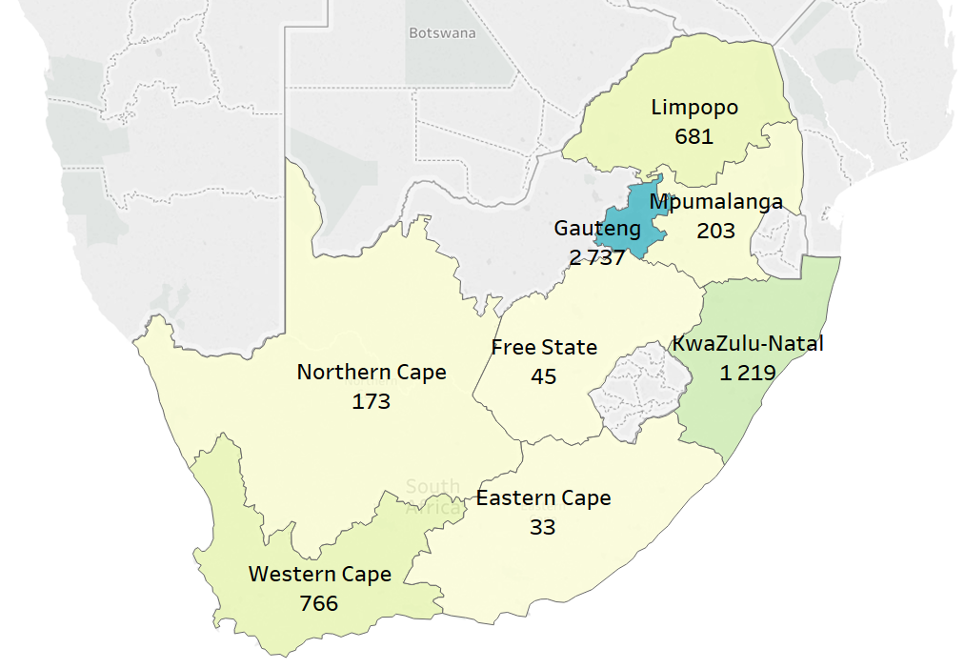
Oral PrEP Initiations
June 2016 – May 2018
From
June 2016 –
May 2018
5 857
initiations
Took place at
34 SITES
across South Africa
        Provincial coverage includes:
        GAUTENG
        FREE STATE
        EASTERN CAPE
        KWAZULU-NATAL
        LIMPOPO MPUMALANGA NORTHERN CAPE
        WESTERN CAPE
Oral PrEP initiations by province
June 2016 – May 2018

Slide 11
Oral PrEP Implementation
Oral PrEP and ART commencements by site type
49 352 (87%)
32 537 (66%)
4 109 (13%)
June 2016 –
May 2018
SW sites
56 475
Neg. HIV tests
# offered PrEP
PrEP initiations
Total HIV tests conducted at implementing SW sites
7 123 (13%)
3 666 (51%)
Pos. HIV tests
ART initiations
10 289 (95%)
2 857 (28%)
1 537 (54%)
April 2017 –
May 2018
MSM sites
10 801
Neg. HIV tests
# offered PrEP
PrEP initiations
Total HIV tests conducted at implementing MSM sites
512 (5%)
563 (110%)
Pos. HIV tests
ART initiations
14 488 (99%)
2 158 (15%)
138 (6%)
14 707
Neg. HIV tests
# offered PrEP
PrEP initiations
October 2017 – May 2018
Youth at university clinic
Total HIV tests conducted at implementing campus clinics
219 (1%)
202 (92%)
Pos. HIV tests
ART initiations
May 2018 –
May 2018
Youth at public facility sites and outreach
185(100%)
73 (39%)
73 (100%)
185
Neg. HIV tests
# offered PrEP
PrEP initiations
Total HIV tests conducted at implementing campus clinics
0 (0%)
0 (0%)
Pos. HIV tests
ART initiations

Slide 12
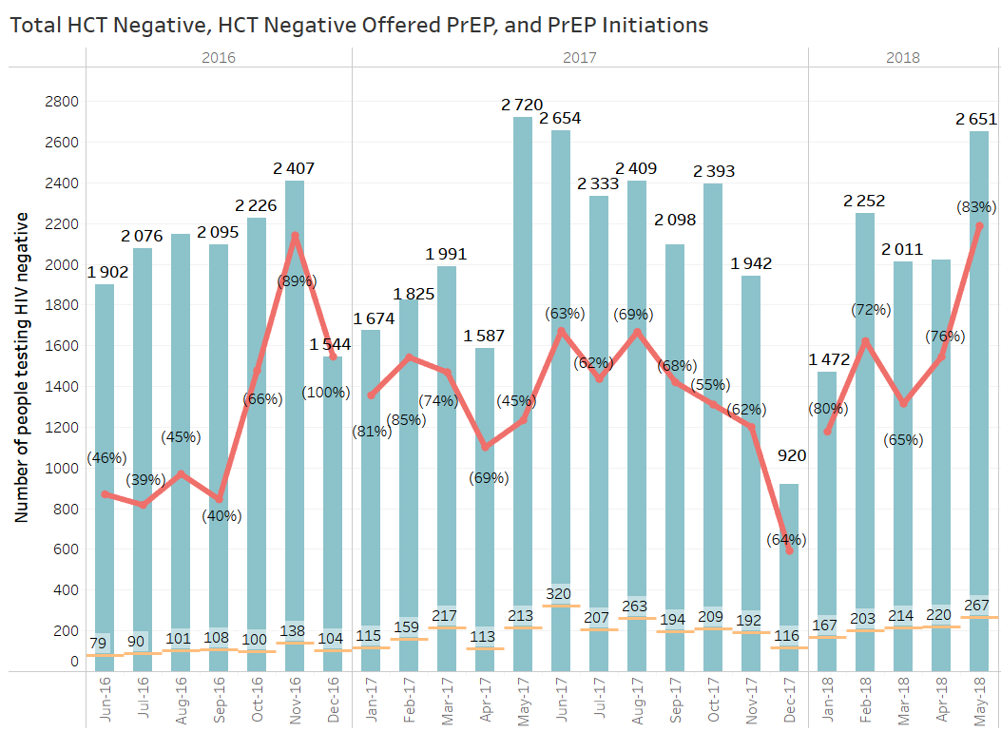

Oral PrEP Implementation
Oral PrEP and ART commencements at Sex Worker sites

Slide 13
PrEP cost effectiveness
(2019-38)
 | Young women (20-24) |  | Female adolescents (15-19) |  | Young men (20-24) |  | Male adolescents (15-19) |  | FSW
Risk group | All | HR | All | HR | All | HR | All | HR | HR
Coverage | 18% | 18% | 18% | 18% | 18% | 18% | 18% | 18% | 95%
No. of person years on PrEP [millions] | 10.2 | 1.8 | 7.0 | 1.9 | 10.4 | 3.7 | 5.5 | 2.5 | 1.7
Incremental cost [billions 2017 ZAR] (% change) | 13.40 (2.3%) | 0.42 (0.1%) | 5.91 (1.0%) | -1.81 (-0.3%) | 13.48 (2.3%) | 2.93 (0.5%) | 5.78 (1.0%) | 1.06 (0.2%) | 0.09 (0.02%)
New HIV infections averted [thousands] (% change) | 138 (3.6%) | 113 (2.9%) | 245 (6.8%) | 225 (6.1%) | 177 (4.7%) | 157 (4.1%) | 161 (4.2%) | 149 (3.9%) | 115 (3.0%)
ICER [2017 ZAR per HIV infection averted] | 97,120 | 3,717 | 24,128 | Cost- saving | 76,274 | 18,680 | 35,940 | 7,108 | 771

Slide 14
Comparison with other interventions
Intervention | ICER (ZAR/HIV averted)
Condom availability | Cost saving
SBCC 1 (HCT, reduction in MSP) | Cost saving
PrEP (Adol F, high risk) | Cost saving
Male medical circumcision | Cost saving
PMTCT | Cost saving
PrEP (FSW) | 771
HCT for sex workers | 1,828
PrEP (YW, high risk) | 3,717
PrEP (Adol M, high risk) | 7,108
Universal treatment | 10,594
General population HCT | 17,169
PrEP (YM, high risk) | 18,680
HCT for adolescents | 21,265
SBCC 2 (condoms) | 22,320
SBCC 3 (condoms, HCT, MMC) | 23,591
PrEP (Adol F, all) | 24,128
PrEP (Adol M, all) | 35,940
PrEP (YM, all) | 76,274
PrEP (YW, all) | 97,120
Early infant male circumcision | 300,962
Infant testing at birth | Dominated

Slide 15
PrEP unit cost (2017 ZAR)
 | Young women (20-24) | Female adolescents (15-19) | FSW | Young Men (20-24) | Male adolescents (15-19) | MSM
First year | 1,918 | 1,915 | 1,939 | 1,900 | 1,900 | 1,890
Follow-up | 1,647 | 1,647 | 1,637 | 1,631 | 1,631 | 1,621
PrEP cost per patient year is R1,621-R1,939
Cost varies between populations by ~6% and between first and follow-up years ~16%

Slide 16
Oral PrEP Implementation for
Key and Vulnerable Populations
Oral PrEP fits easily into combination prevention and SRH services
Non-judgemental, non-stigmatising attitudes from clinic staff members is critical, especially for adolescents and young people
Outreach is key in reaching target population, and equally important for follow-up
Uptake of Mobile services is higher than fixed clinics
Flexibility in clinic hours greatly increases uptake
Peer-led programmes result in higher demand creation and uptake
Clear, regular communication is important
Special attention to client needs in first 30 days of PrEP use is critical
  Side effects
  Adherence
  Psychosocial support
Lessons learned

Slide 17
Oral PrEP Implementation for
Key and Vulnerable Populations
A professional nurse trained to initiate ART and deliver sexual reproductive health services, a counsellor and a peer educator are the basic staff required
Expansion of PrEP to public facilities will require special attention to staff attitudes and responsiveness to key and vulnerable populations
Support for retention on PrEP and ART especially side-effect management is critical
Tracking and tracing clients who fail to return requires special attention
Lessons learned

Slide 18
Oral PrEP Implementation for
Key and Vulnerable Populations
PrEP can only be delivered from a health facility that meets the regulatory criteria to keep and dispense scheduled medication.
Making PrEP available to key and vulnerable populations who already have limited access to health services
Limited number of health facilities that are sensitive to the needs of key populations and adolescents and youth
Promoting and marketing a new HIV prevention intervention amongst sex workers and transgender who already feel marginalised and discriminated against
The experience of side effects from PrEP drugs
Low uptake and retention of PrEP amongst sex workers
Challenges

Slide 19
THANK YOU!

